Slide 1
Accelerated diffusion-weighted MRI at 7T: Joint reconstruction for shift-encoded navigated interleaved echo planar imaging (JETS-NAViEPI)
Zhengguo Tan¹, Patrick Liebig², Robin Heidemann^{1,2},
Frederik Laun³, Florian Knoll¹
Artificial Intelligence in Biomedical Engineering, University of Erlangen-Nuremberg, Erlangen, Germany
Siemens Healthcare GmbH, Erlangen, Germany
University Hospital Erlangen, University of Erlangen-Nuremberg, Erlangen, Germany
Notes:
You do NOT need a title slide, as your video will appear with the title. (You could delete this slide)
But IF you really want to have one so you can use the same video elsewhere, you should put that information on the second slide.
For recording, you could read the title, or quickly past the cover slide and this slide before you start narration.
Suggestion – when you record the video, quickly move past this slide so it serves only as a title.
(You will probably have other slides to describe the Purpose / Introduction / Motivation / Goal, so use those to introduce your work)

Slide 2
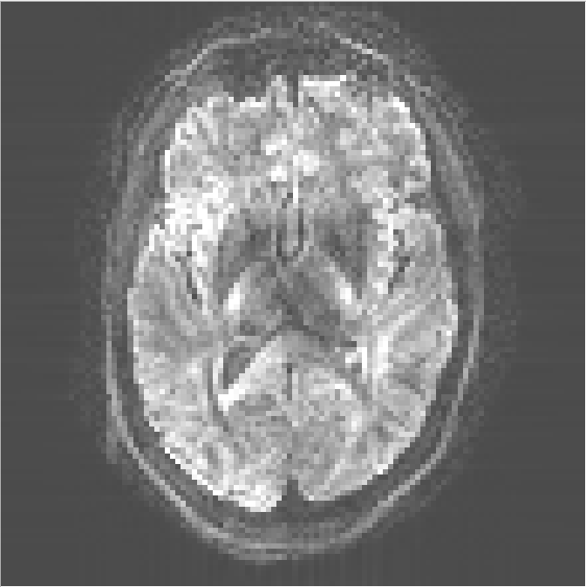
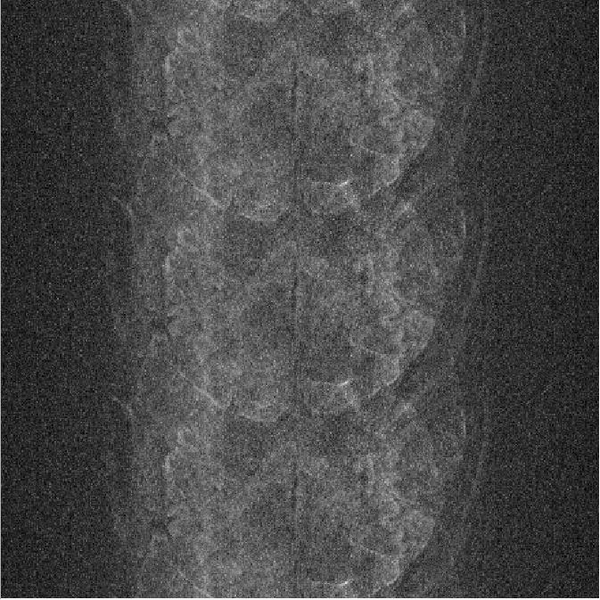
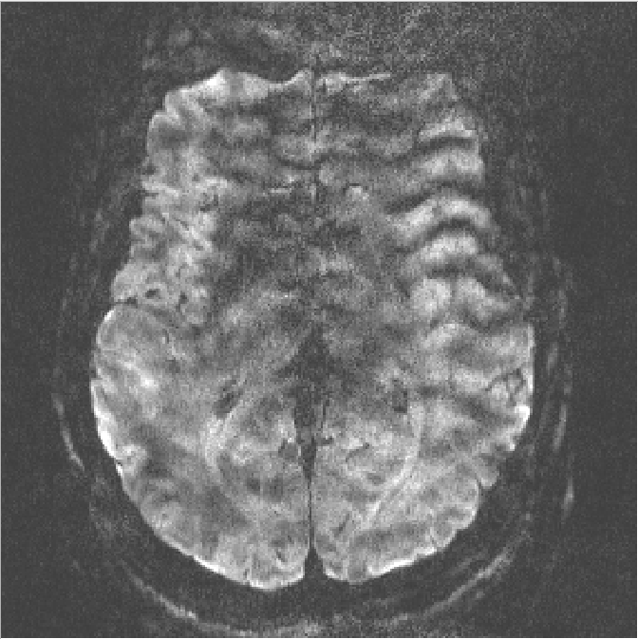
Motivation
Diffusion-weighted MRI (DWI) suffers from:
Limited spatial resolution
& poor SNR
Shot-to-shot
phase variation
Motion
Notes:
This is a section heading slide, which you will link to from your summary text heading.
Put some information on this slide, without much animation, so you can quickly show information from the link, even when the video is paused.
You may want to use a different tile style for section heading slides compared to other slides.

Slide 3
Goal
To develop high spatial-angular-temporal resolution DWI at 7 T.
Sub-millimeter spatial resolution
Multi-shell q-space sampling
Undersampled complementary k-space acquisition
Notes:
This is a section heading slide, which you will link to from your summary text heading.
Put some information on this slide, without much animation, so you can quickly show information from the link, even when the video is paused.
You may want to use a different tile style for section heading slides compared to other slides.
You do not have to use the Synposis headings – and you can have up to 8 sections that are linked.

Slide 4
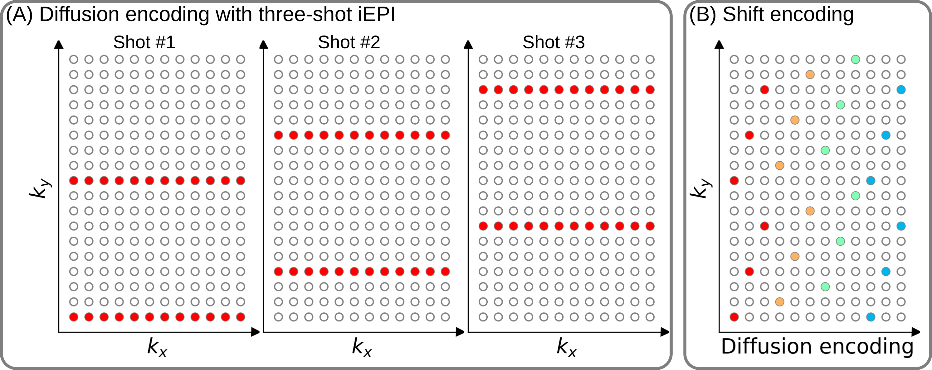
Approach: Shift Encoding
Enables complementary k-q-space sampling
Notes:
This is a section heading slide, which you will link to from your summary text heading.
Put some information on this slide, without much animation, so you can quickly show information from the link, even when the video is paused.
You may want to use a different tile style for section heading slides compared to other slides.

Slide 5
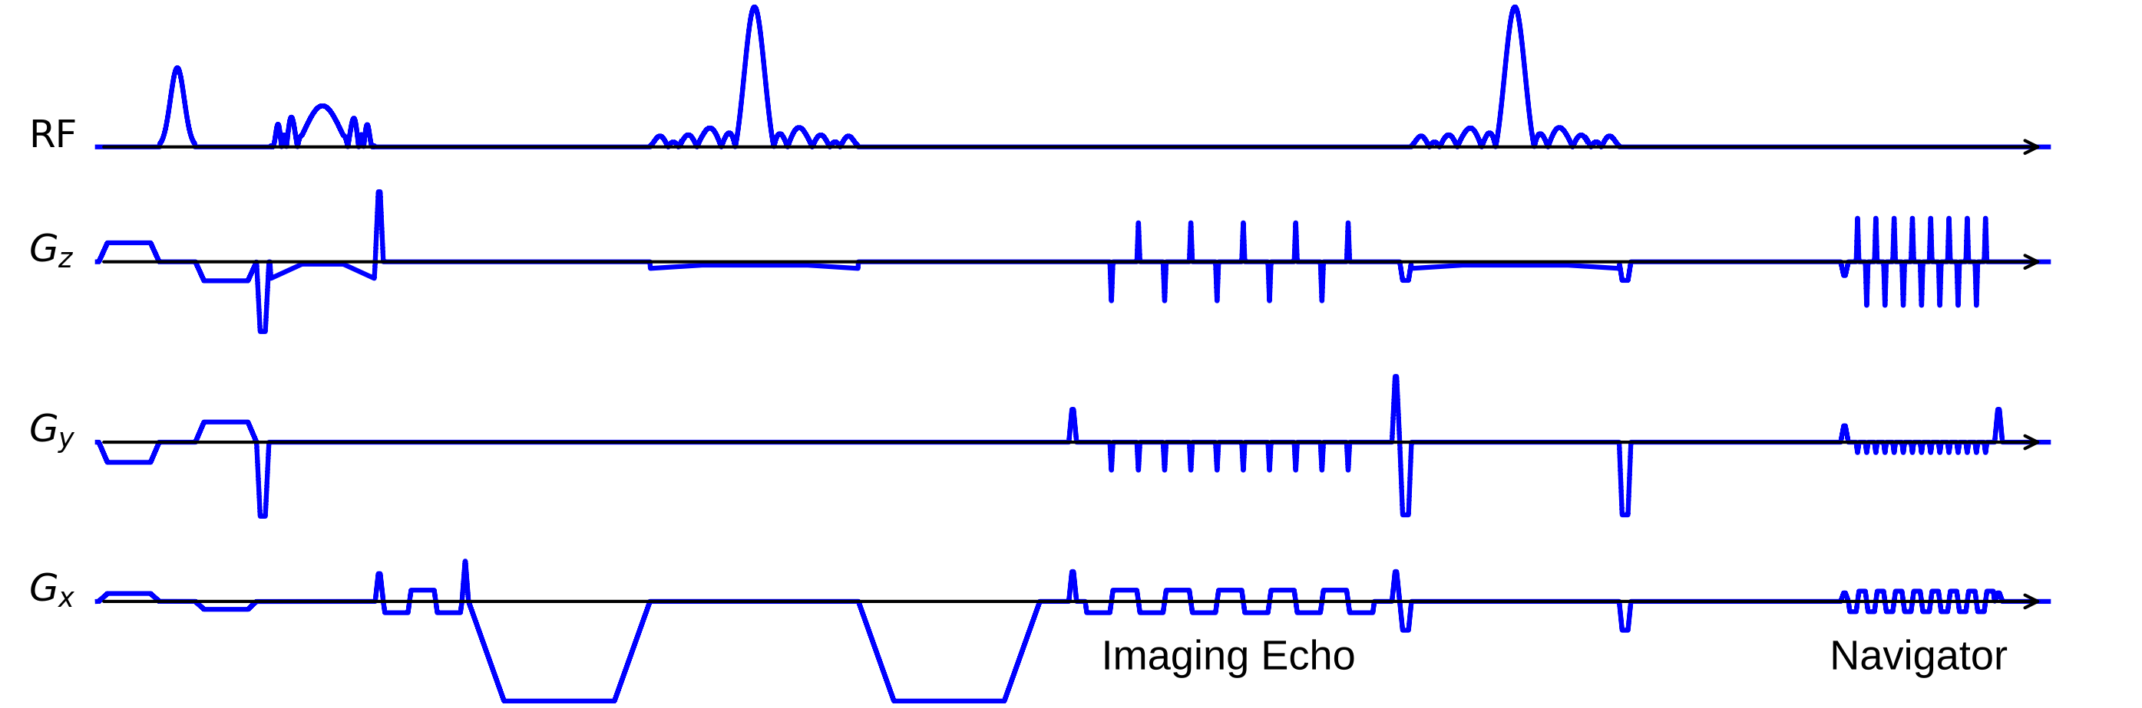
Approach: NAViEPI – iEPI Meets rsEPI
Consistent echo spacing between imaging and navigator echoes
Minimal distortion mismatch between echoes
Flexible number of shots for high spatial resolution
Reliable shot-to-shot phase estimation
Notes:
This is a section heading slide, which you will link to from your summary text heading.
Put some information on this slide, without much animation, so you can quickly show information from the link, even when the video is paused.
You may want to use a different tile style for section heading slides compared to other slides.

Slide 6
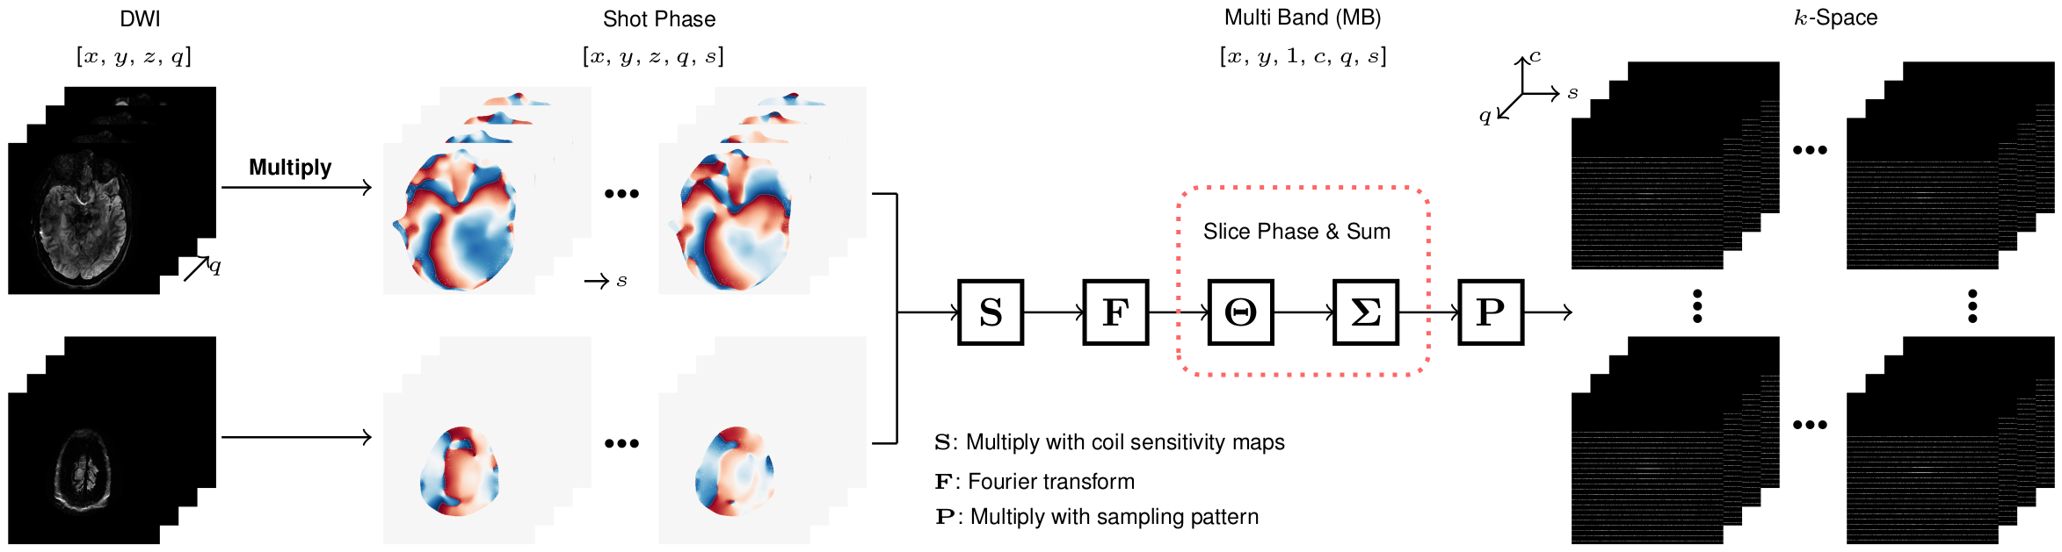
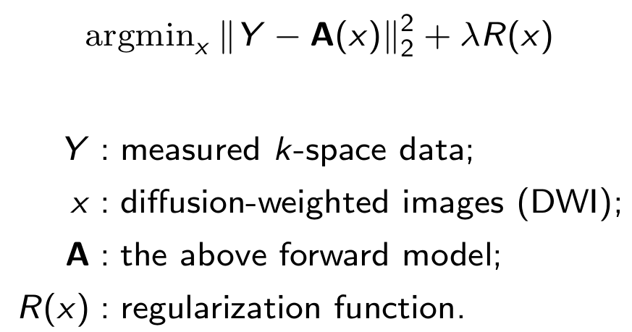
Approach: Joint Reconstruction
Notes:
This is a section heading slide, which you will link to from your summary text heading.
Put some information on this slide, without much animation, so you can quickly show information from the link, even when the video is paused.
You may want to use a different tile style for section heading slides compared to other slides.

Slide 7
Experimental Setup
Experiment | #1 | #2 | #3
Spatial resolution | 1.0 mm ISO | 0.5 x 0.5 x 2.0 mm³ | 1.0 mm ISO
Shots | 4 | 5 | 2
Diffusion directions | 20 | 3 | 126
b-values (s/mm²) | 1000 | 1000 | 1000, 2000, 3000
Acceleration | 1 x 3 | 3 x 2 | 3 x 3
Scan Time (min) | 10:42 | 1:38 | 22:25
Notes:
This is a sample slide that is NOT a section heading.
You may put as many slides between headings as you would like, with any titles.

Slide 8
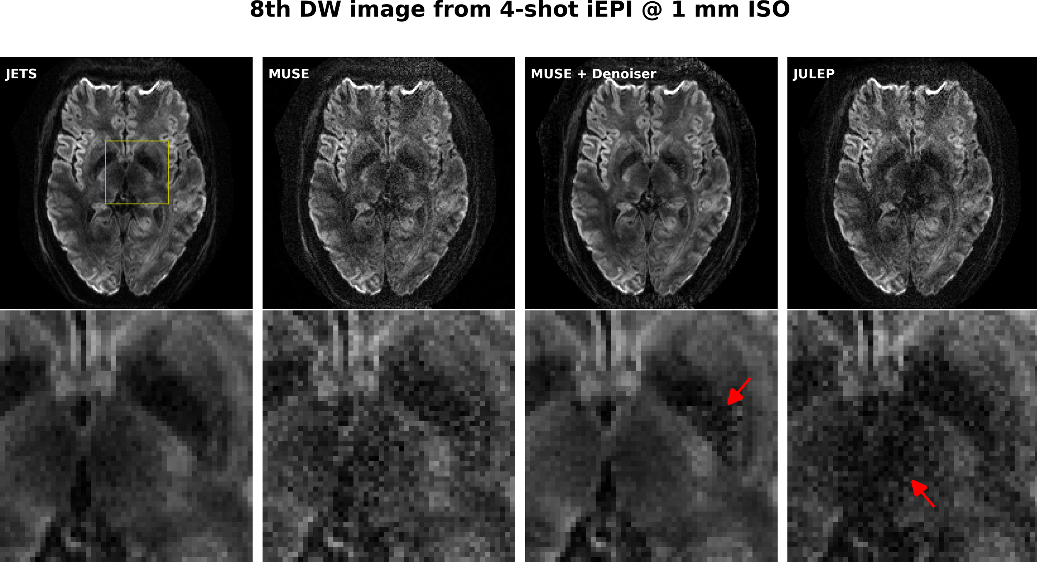
Result: Effective JETS Reconstruction
Notes:
This is a section heading slide, which you will link to from your summary text heading.
Put some information on this slide, without much animation, so you can quickly show information from the link, even when the video is paused.
You may want to use a different tile style for section heading slides compared to other slides.

Slide 9
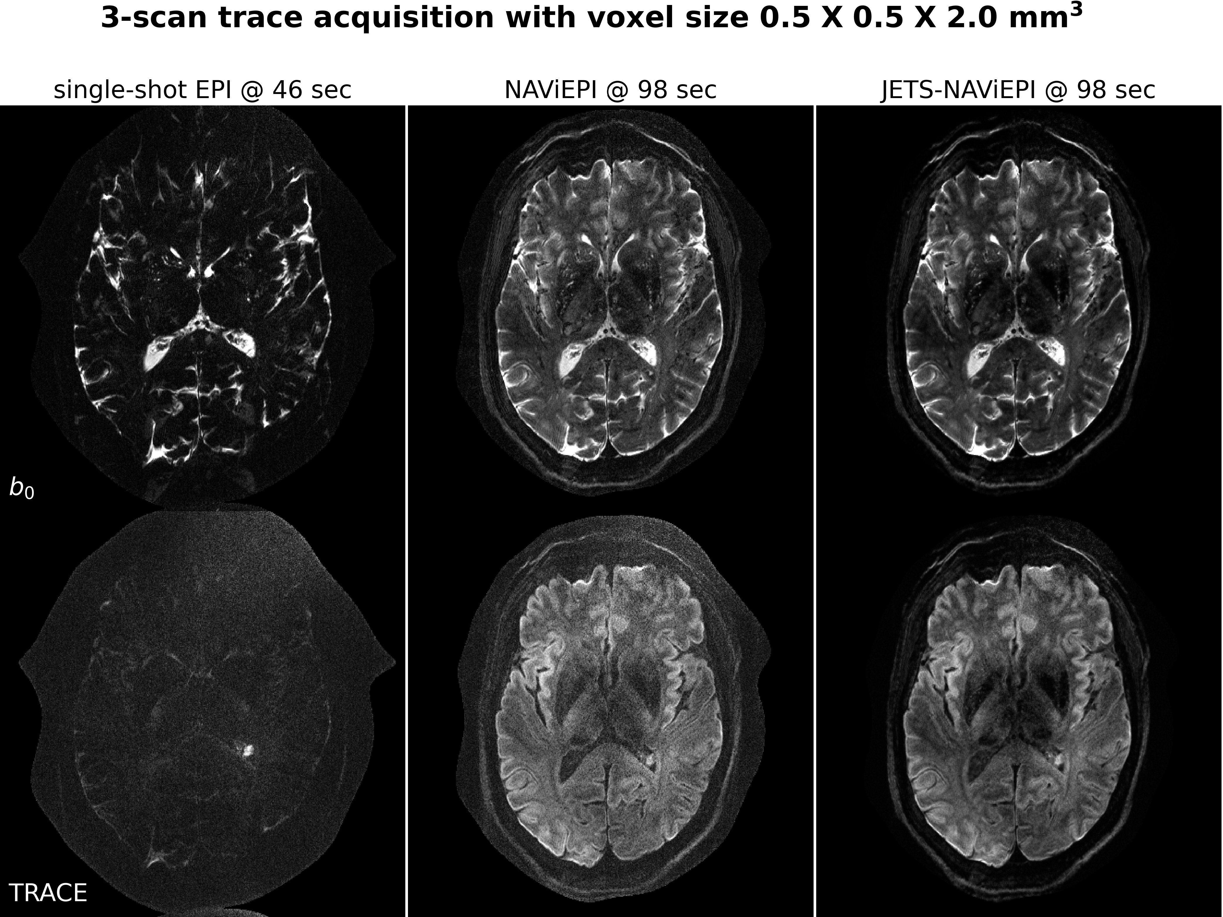
Result: Efficient NAViEPI Sampling
Notes:
This is a section heading slide, which you will link to from your summary text heading.
Put some information on this slide, without much animation, so you can quickly show information from the link, even when the video is paused.
You may want to use a different tile style for section heading slides compared to other slides.

Slide 10
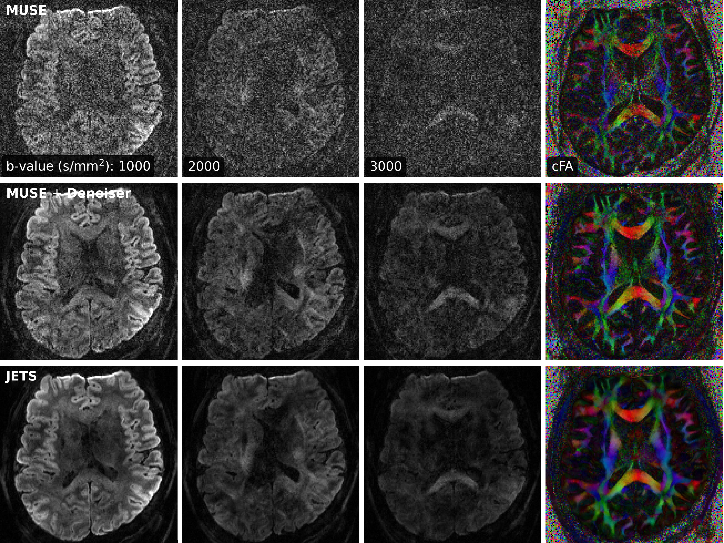
Result: 3-Shell DTI
Notes:
This is a section heading slide, which you will link to from your summary text heading.
Put some information on this slide, without much animation, so you can quickly show information from the link, even when the video is paused.
You may want to use a different tile style for section heading slides compared to other slides.

Slide 11
Open-Source Codes
Accepted by Imaging Neuroscience:
https://doi.org/10.1162/imag_a_00085
Codes & Data:
https://github.com/ZhengguoTan/NAViEPI
Notes:
This is a sample slide that is NOT a section heading.
You may put as many slides between headings as you would like, with any titles.

Slide 12
Impact
JETS-NAViEPI enables
accelerated sub-millimeter resolution brain DWI at 7T;
clinically relevant 3-scan trace and neuroscientific DTI protocols.
zhengguo.tan@gmail.com
Notes:
This is a section heading slide, which you will link to from your summary text heading.
Put some information on this slide, without much animation, so you can quickly show information from the link, even when the video is paused.
You may want to use a different tile style for section heading slides compared to other slides.

